Slide 1
AmazingMartEU2Geo Sales Analysis
Power BI report on
by – Rohit Rajendra Gaikwad

Slide 2
Data Description :
This dataset include sales data of Amazing Mart from 2011 to 2014.
This dataset has two tables ListOfOders and OrderBreakdown.
First table (ListOfOders) has twelve columns named as: Order ID, Order Date, Customer Name, City, Country, Region, Segment, Ship Date, Ship Mode, State, Ion, Iot.
Second table (OrderBreakdown) has eight columns named as: Order ID, Product Name, Discount, Sales, Profit, Quantity, Category, Subcategory.
Dataset source : https://powerbidocs.com/2019/11/28/power-bi-sample-data-set-for-practice/

Slide 3
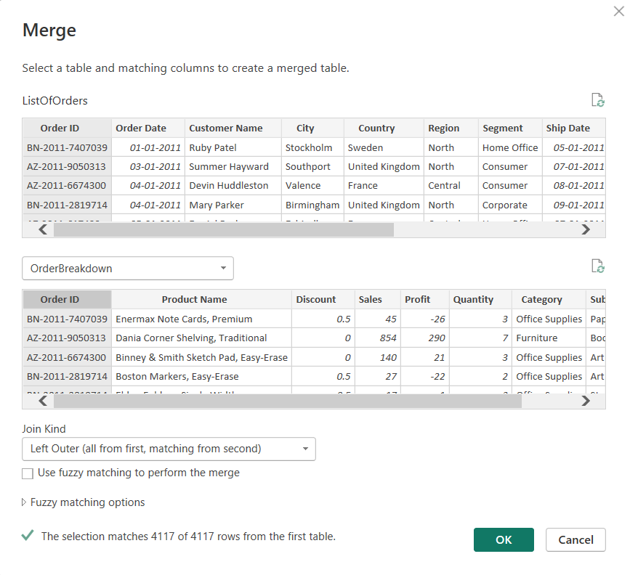
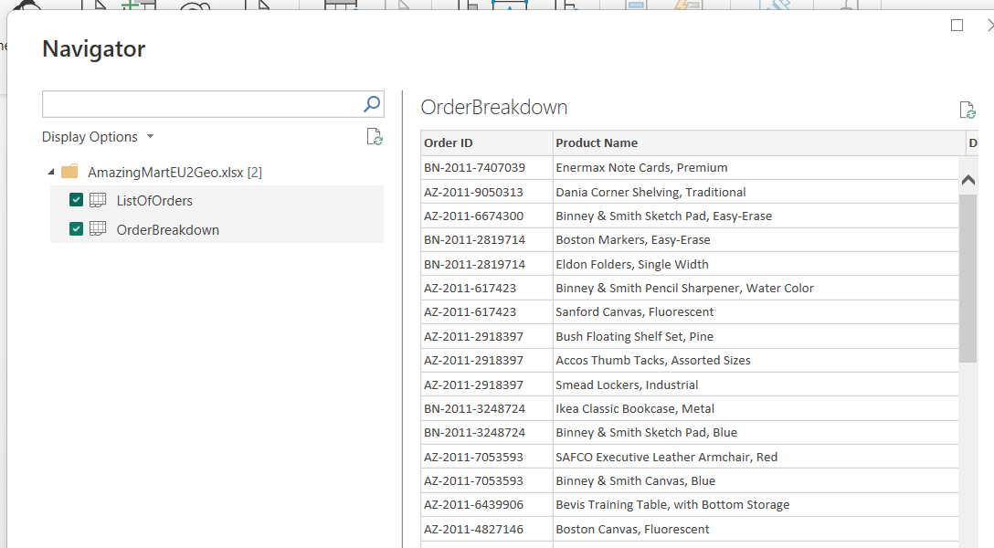
ETL :
Dataset was imported from an excel file.
After Importing every entity is checked In Power Query Editor for nulls, duplicates and Invalid data.
In dataset fist table contained info regarding orders and second table contained additional info like profit, sales and discount.
So we have merged two tables for easy handling and simplification.

Slide 4
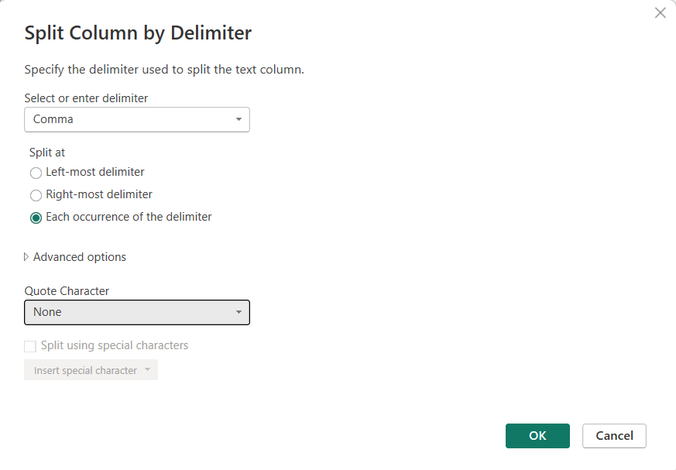
M-query/ DAX:
In dataset we have two Date columns ‘Order Date’ and ‘Ship Date’. Here to calculate lag in shipping item in terms of days passed we have used M-query.
‘Product name’ column also contained some additional info separated by delimiter, to remove that we have used DAX.

Slide 5
Visualization:
Visualization is very important part in terms of analysing and extracting information from data.
After modelling the data different reports are created in Report View.
For simplification we have also created different measures of sales and profit.
Using different tiles from reports finally dashboard is created.
GitHub link of project: https://github.com/RohitG57/Amazing-Mart-Sales-Analysis-using-Power-BI

Slide 6
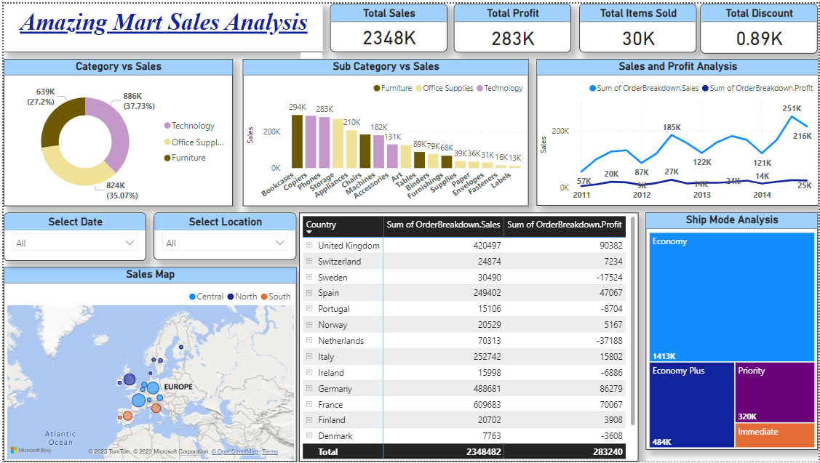

Slide 7

Learnings:
Time Management
Importance of Data Transforming
M-query/ DAX
Importance of different graphs

Slide 8
Analysis:
This sales data is from Europe further divided into country's, states and cities.
Amazing mart has three main categories as Technology, Office supplies and Furniture. Out of this Technology has the highest sales but Office supplies brings more profit. This may be due to Office supplies has highest discount.
In each year sales increase from second quarter and Profit reaches peak in third quarter.
Sales of furniture is more in North and South region and discount offered is very less compared to central region.
Year on year sales is increasing and bringing more profit.

Slide 9
Thank You

